Slide 1
Excitation of a surface plasmon polariton (SPP) via prism coupling
Review the properties of evanescent fields, induced via total internal reflection (prism coupling )
Review the properties of an SPP
See a simulation of an SPP excitation via total internal reflection (prism coupling)

Slide 2
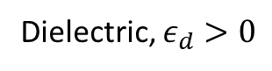
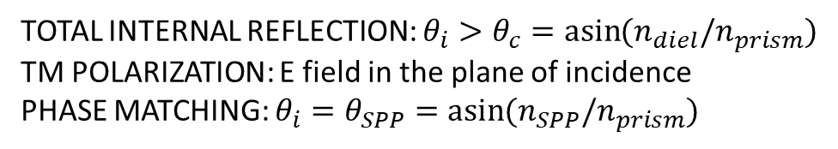
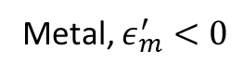
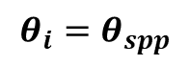
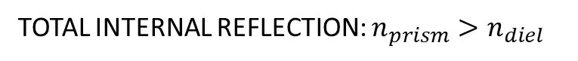
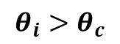
TOTAL INTERNAL REFLECTION: $n_{prism}>n_{diel}$
TOTAL INTERNAL REFLECTION + TM POL. + PHASE MATCHING
Prism
Prism
$${θ_{i}>θ}_{c}$$
$${θ_{i}=θ}_{spp}$$
Metal
Dielectric
Dielectric
SURFACE PLASMON POLARITON (SPP)
TOTAL INTERNAL REFLECTION: $θ_{i}>θ_{c}=\operatorname{asin}{(n_{diel}/n_{prism})}$
TM POLARIZATION: E field in the plane of incidence
PHASE MATCHING: $θ_{i}=θ_{SPP}=\operatorname{asin}{(n_{SPP}/n_{prism})}$
Metal, $ε_{m}^{′}<0$
Dielectric, $ε_{d}>0$

Slide 3
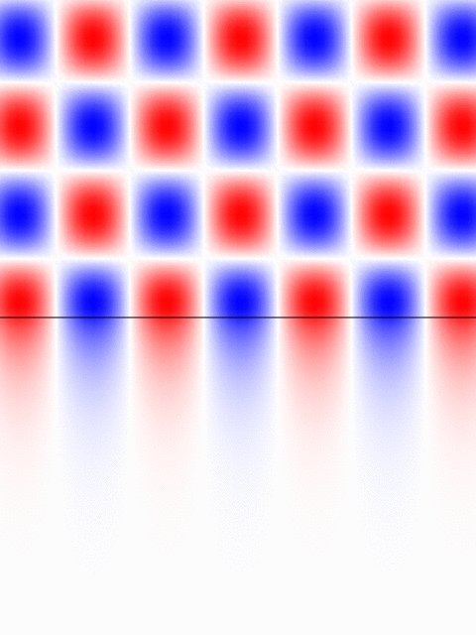
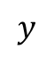
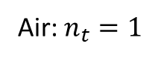
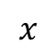
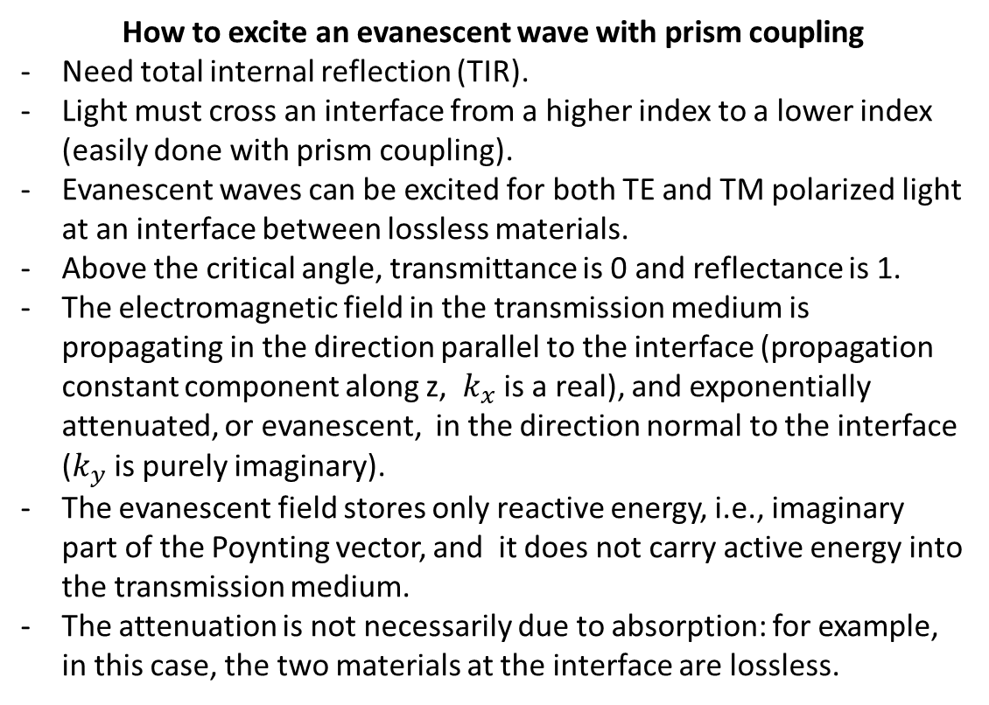
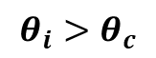
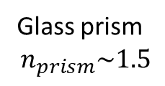
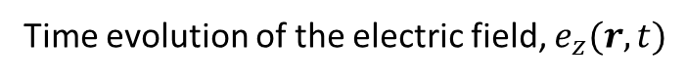
Properties of an evanescent wave
Time evolution of the electric field, $e_{z}(r,t)$
Glass prism
$$n_{prism}\sim 1.5$$
How to excite an evanescent wave with prism coupling
Need total internal reflection (TIR).
Light must cross an interface from a higher index to a lower index (easily done with prism coupling).
Evanescent waves can be excited for both TE and TM polarized light at an interface between lossless materials.
Above the critical angle, transmittance is 0 and reflectance is 1.
The electromagnetic field in the transmission medium is propagating in the direction parallel to the interface (propagation constant component along z, $k_{x}$ is a real), and exponentially attenuated, or evanescent, in the direction normal to the interface ($k_{y}$ is purely imaginary).
The evanescent field stores only reactive energy, i.e., imaginary part of the Poynting vector, and it does not carry active energy into the transmission medium.
The attenuation is not necessarily due to absorption: for example, in this case, the two materials at the interface are lossless.
$${θ_{i}>θ}_{c}$$
$$y$$
Air: $n_{t}=1$
$$x$$

Slide 4
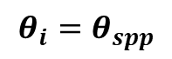
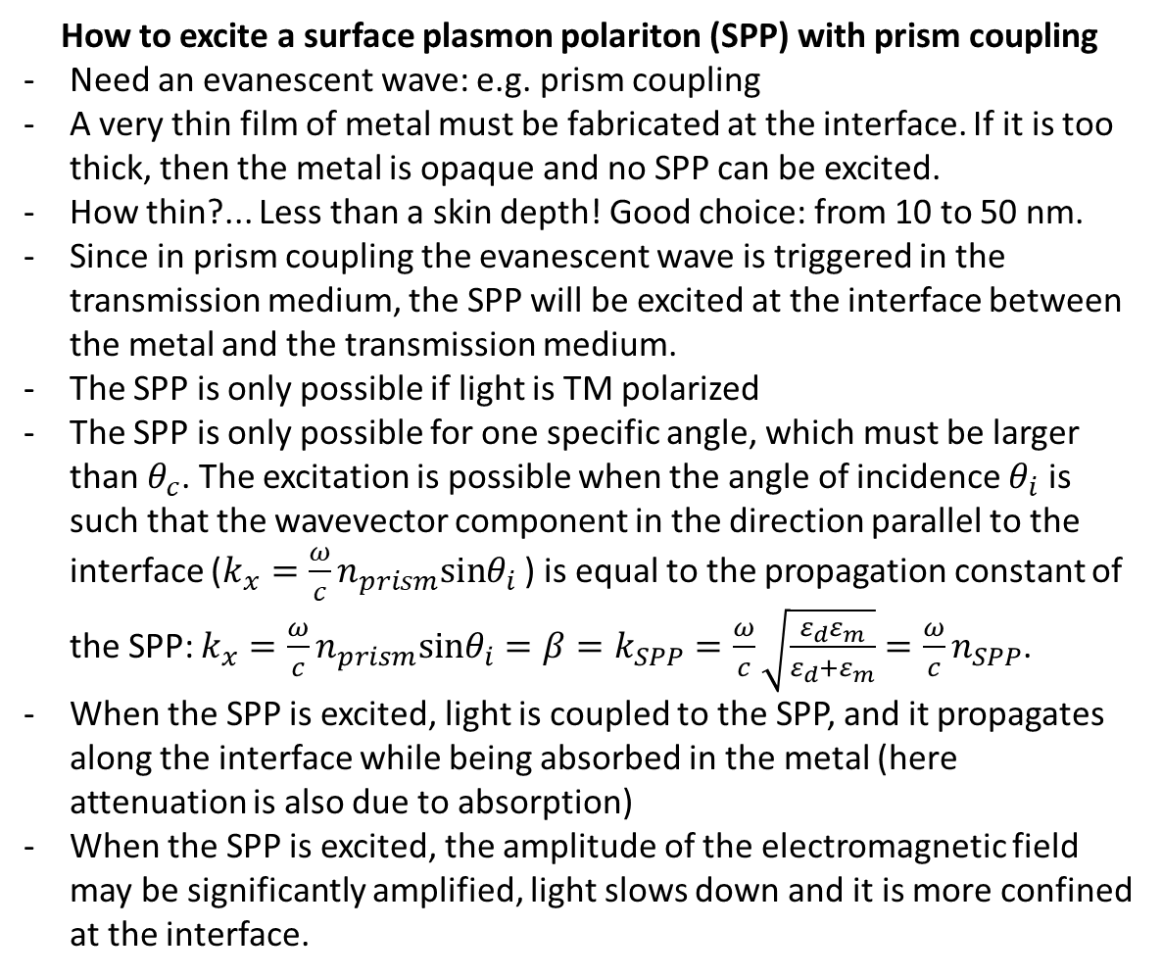
Properties of an SPP
How to excite a surface plasmon polariton (SPP) with prism coupling
Need an evanescent wave: e.g. prism coupling
A very thin film of metal must be fabricated at the interface. If it is too thick, then the metal is opaque and no SPP can be excited.
How thin?... Less than a skin depth! Good choice: from 10 to 50 nm.
Since in prism coupling the evanescent wave is triggered in the transmission medium, the SPP will be excited at the interface between the metal and the transmission medium.
The SPP is only possible if light is TM polarized
The SPP is only possible for one specific angle, which must be larger than $θ_{c}$. The excitation is possible when the angle of incidence $θ_{i}$ is such that the wavevector component in the direction parallel to the interface ($k_{x}=\frac{ω}{c}n_{prism}sinθ_{i}$ ) is equal to the propagation constant of the SPP: $k_{x}=\frac{ω}{c}n_{prism}sinθ_{i}=β=k_{SPP}=\frac{ω}{c}\sqrt{\frac{ε_{d}ε_{m}}{ε_{d}+ε_{m}}}=\frac{ω}{c}n_{SPP}$.
When the SPP is excited, light is coupled to the SPP, and it propagates along the interface while being absorbed in the metal (here attenuation is also due to absorption)
When the SPP is excited, the amplitude of the electromagnetic field may be significantly amplified, light slows down and it is more confined at the interface.
TOTAL INTERNAL REFLECTION
TM POL.
PHASE MATCHING
Prism
$${θ_{i}=θ}_{spp}$$
Dielectric

Slide 5
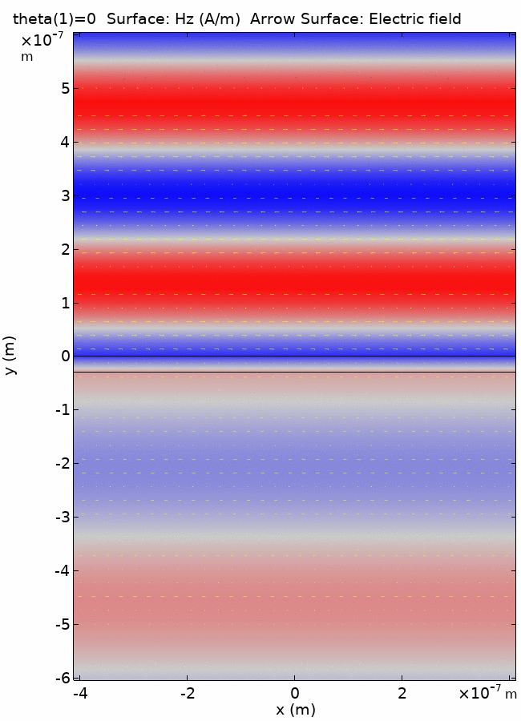
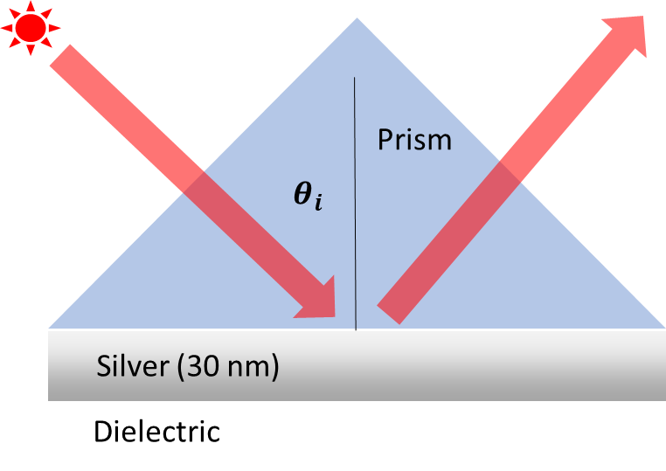
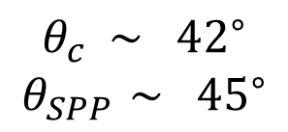
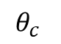
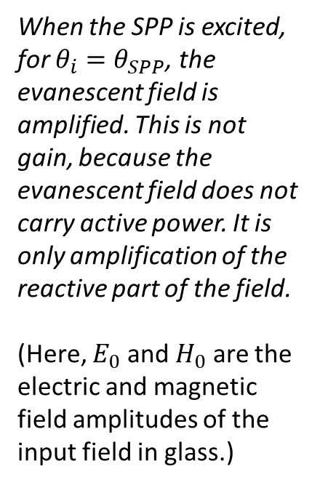
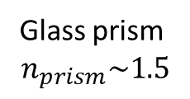
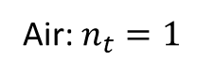
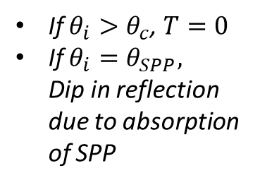
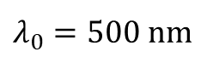
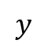
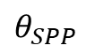
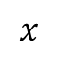
E.m. field phasors (real part)
Simulation of an SPP
$λ_{0}=500$nm
$$θ_{c} \sim {42}^{∘}$$
$$θ_{SPP }\sim {45}^{∘}$$
Glass prism
$$n_{prism}\sim 1.5$$
Air
When the SPP is excited, for $θ_{i}=θ_{SPP}$, the evanescent field is amplified. This is not gain, because the evanescent field does not carry active power. It is only amplification of the reactive part of the field.
(Here, $E_{0}$ and $H_{0}$ are the electric and magnetic field amplitudes of the input field in glass.)
Silver film (30 nm)
If $θ_{i}>θ_{c}$, $T=0$
If $θ_{i}=θ_{SPP},$ Dip in reflection due to absorption of SPP
$$θ_{SPP}$$
$$θ_{c}$$
$$y$$
Air: $n_{t}=1$
$$x$$

Slide 6
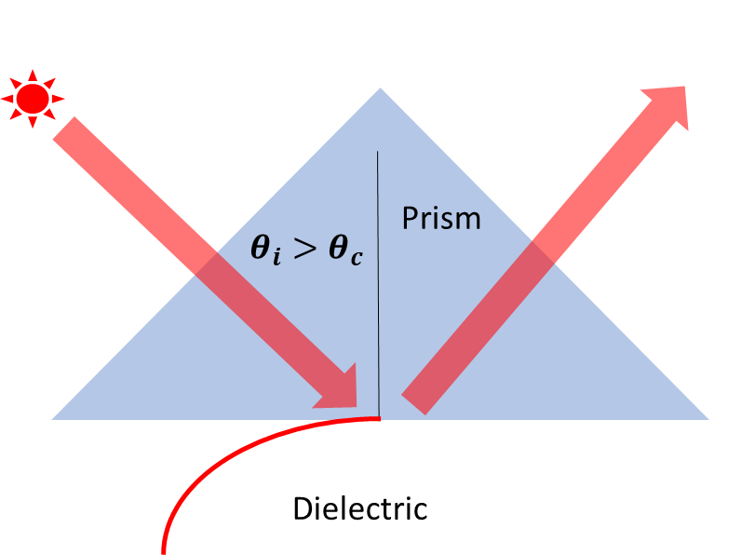
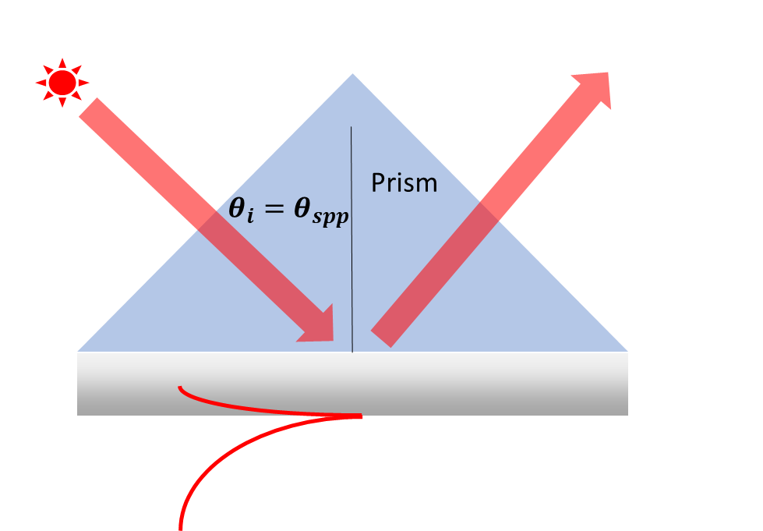
Evanescent wave at prism-dielectric interface with TIR
SPP at metal-dielectric interface with TIR

Slide 7
Evanescent wave at prism-dielectric interface with TIR
SPP at metal-dielectric interface with TIR

